Slide 1

Participation Tools
Workstream Update
November 2024

Slide 2
Workstream Update
Workstream Name: | Participation Tools
Roadmap Pillar: | Pillar 1: Make adoption easier
Lead: | James Bush
Workstream Objectives this PI: | Develop tools that can be used to build a low-cost “scheme connection in a box” for DFSPs. E.g. buy a cheap “connect to a {Mojaloop}” box, take it home and join a scheme. Optimise deployment of SDK (refining of SDK and tools into ITK). Prove a real-life use-case e.g. savings deposits to a small MFI. Clarify and understand the strategic imperative behind this workstream.
Progress Against Objectives: | Objectives 1, 2 & 3 MVP delivered (see demonstration). Objective 4 iterating.
Roadblocks: | None at present
Support Needed: | Product input from community members, adopters, DFSPs & System Integrators (both technical and business focused input) Software engineering contributions to work on SDK, PHEE etc…
Notes:
Handover to Devarsh - has working on core test harness and other tools used for DFSP onboarding journey.

Slide 3
“Low-cost scheme connection in a box”
Q: Why did we focus on this objective?
A: “One loop for all”
Small participants e.g. MFIs, SACCOs etc… should be able to participate in schemes with larger institutions e.g. MoMo, Banks.
Integration and onboarding tools exist in our ecosystem to help larger participants join and integrate with Mojaloop schemes (PHEE, PM4ML).
This PI we have focused on addressing the gap in support for smaller participants.

Slide 4
“Low-cost scheme connection in a box”
Creation of “Mojaloop Integration Toolkit” (ITK).
Clearer product boundaries and requirements.
Includes existing integration SDK components.
Includes best practice guidance documentation for integration projects.
Increasing feature set bringing in new components to better address emerging requirements.

Slide 5
“Low-cost scheme connection in a box”
Live Demonstration!
Test ITK integration based on low-cost hardware
Raspberry Pi-5 (approx $100)
MifosX as core banking system typical of smaller FSPs.
Load tests (using k6 framework) to gather data on performance.
All Mojaloop security features:
Mutually authenticated TLSv1.2 (X.509).
JWS digital signatures.
Cryptographic “hash-lock” condition and fulfilment.

Slide 6
“Low-cost scheme connection in a box”
Live Demonstration!
Test use-case:
Savings deposits from mobile money accounts to MFI savings accounts.
Simulating 125 “users” making savings deposits from their MoMo wallets to MFI savings accounts.
1000 transactions.

Slide 7
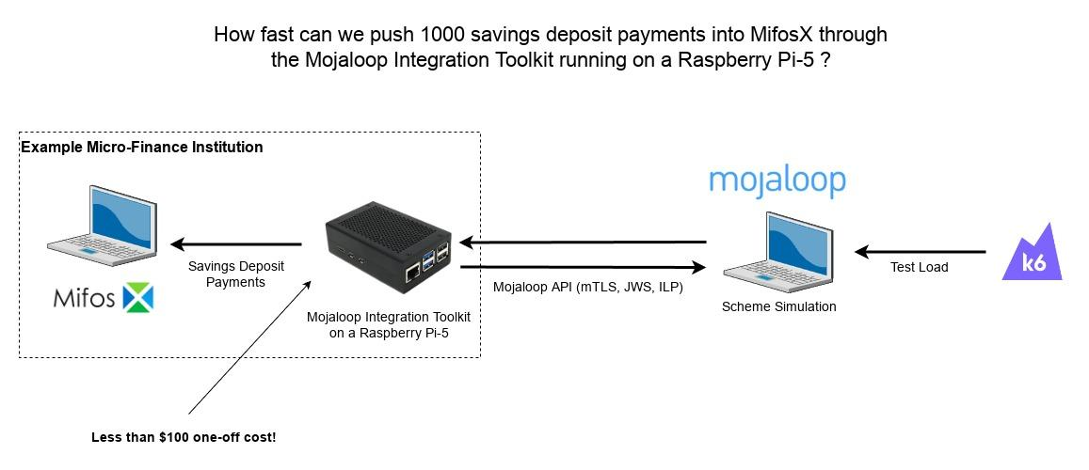
“Low-cost scheme connection in a box”
Live Demonstration!

Slide 8
“Low-cost scheme connection in a box”
Competition!
Guess how many payments per second can be achieved, on average, over the duration of the test, through the Raspberry Pi based integration layer.
The closest guess will win the Raspberry Pi-5 device used during the demonstration.

Slide 9

Grateful thanks to all contributors!

Slide 10

Reach out to participate
Email: james.bush@mojaloop.io
Mojaloop Slack: #ws-participation-tools

